Slide 1
What do we know about soil-atmosphere COS fluxes?
Notes:
So what do we know about soil-atmosphere exchanges ?
Until today we know that most of the soil are OCS sinks.
The OCS soil uptake have an optimum with soil moisture and it also varies with seasonal changes in soil temperature.
We also know that some soils, the anoxic one mainly can acts as a sources of OCS.
This source has a Q10 shape, that’s mean that it has no optimum, it continuously increases with the increasing temperature.
Until today we know that the catalysis of OCS hydrolysis by CA plays a really a crucial role in the soil OCS uptake.
Indeed the OCS uptake by soils is strongly reduced when CA inhibitors are used.
By the way this CA is contain in soils microorganisms.
The OCS uptake temperature response can be explained by the temperature response of the enzyme itself, or by changes in population diversity.
To continue with the hydrolysis process, we could expect that it becomes limiting when soil moisture is too low and reduces the size of the reaction volume.
OCS uptake can also be limited by high soil moisture content emphasising the diffusion limitations when the soil is near saturation
A model that includes all these different processes (production, diffusion, CA-catalysed hydrolysis) should then reproduce, at least qualitatively the observed OCS response to soil moisture and temperature.

Slide 2

What do we know about soil-atmosphere COS fluxes?
COS diffusion
- depends on soil structure
- limited if soil moisture is near saturation
Notes:
So what do we know about soil-atmosphere exchanges ?
Until today we know that most of the soil are OCS sinks.
The OCS soil uptake have an optimum with soil moisture and it also varies with seasonal changes in soil temperature.
We also know that some soils, the anoxic one mainly can acts as a sources of OCS.
This source has a Q10 shape, that’s mean that it has no optimum, it continuously increases with the increasing temperature.
Until today we know that the catalysis of OCS hydrolysis by CA plays a really a crucial role in the soil OCS uptake.
Indeed the OCS uptake by soils is strongly reduced when CA inhibitors are used.
By the way this CA is contain in soils microorganisms.
The OCS uptake temperature response can be explained by the temperature response of the enzyme itself, or by changes in population diversity.
To continue with the hydrolysis process, we could expect that it becomes limiting when soil moisture is too low and reduces the size of the reaction volume.
OCS uptake can also be limited by high soil moisture content emphasising the diffusion limitations when the soil is near saturation
A model that includes all these different processes (production, diffusion, CA-catalysed hydrolysis) should then reproduce, at least qualitatively the observed OCS response to soil moisture and temperature.

Slide 3

What do we know about soil-atmosphere COS fluxes?
COS uptake
- optimum with soil moisture
- varies with temperature
COS diffusion
- depends on soil structure
- limited if soil moisture is near saturation
Notes:
So what do we know about soil-atmosphere exchanges ?
Until today we know that most of the soil are OCS sinks.
The OCS soil uptake have an optimum with soil moisture and it also varies with seasonal changes in soil temperature.
We also know that some soils, the anoxic one mainly can acts as a sources of OCS.
This source has a Q10 shape, that’s mean that it has no optimum, it continuously increases with the increasing temperature.
Until today we know that the catalysis of OCS hydrolysis by CA plays a really a crucial role in the soil OCS uptake.
Indeed the OCS uptake by soils is strongly reduced when CA inhibitors are used.
By the way this CA is contain in soils microorganisms.
The OCS uptake temperature response can be explained by the temperature response of the enzyme itself, or by changes in population diversity.
To continue with the hydrolysis process, we could expect that it becomes limiting when soil moisture is too low and reduces the size of the reaction volume.
OCS uptake can also be limited by high soil moisture content emphasising the diffusion limitations when the soil is near saturation
A model that includes all these different processes (production, diffusion, CA-catalysed hydrolysis) should then reproduce, at least qualitatively the observed OCS response to soil moisture and temperature.

Slide 4
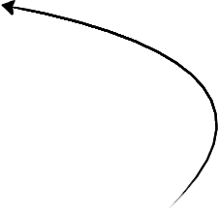
What do we know about soil-atmosphere COS fluxes?
COS uptake
- optimum with soil moisture
- varies with temperature
CA
COS diffusion
- depends on soil structure
- limited if soil moisture is near saturation
COS hydrolysis
- enhanced by the enzyme CA
- limited if soil moisture is low
Notes:
So what do we know about soil-atmosphere exchanges ?
Until today we know that most of the soil are OCS sinks.
The OCS soil uptake have an optimum with soil moisture and it also varies with seasonal changes in soil temperature.
We also know that some soils, the anoxic one mainly can acts as a sources of OCS.
This source has a Q10 shape, that’s mean that it has no optimum, it continuously increases with the increasing temperature.
Until today we know that the catalysis of OCS hydrolysis by CA plays a really a crucial role in the soil OCS uptake.
Indeed the OCS uptake by soils is strongly reduced when CA inhibitors are used.
By the way this CA is contain in soils microorganisms.
The OCS uptake temperature response can be explained by the temperature response of the enzyme itself, or by changes in population diversity.
To continue with the hydrolysis process, we could expect that it becomes limiting when soil moisture is too low and reduces the size of the reaction volume.
OCS uptake can also be limited by high soil moisture content emphasising the diffusion limitations when the soil is near saturation
A model that includes all these different processes (production, diffusion, CA-catalysed hydrolysis) should then reproduce, at least qualitatively the observed OCS response to soil moisture and temperature.

Slide 5
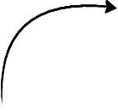
What do we know about soil-atmosphere COS fluxes?
COS uptake
COS uptake
- optimum with soil moisture
- optimum with soil moisture
COS source
- anoxic soils
- Q10 response
- varies with temperature
CA
COS diffusion
- depends on soil structure
- limited if soil moisture is near saturation
COS hydrolysis
- enhanced by the enzyme CA
- limited if soil moisture is low
Notes:
So what do we know about soil-atmosphere exchanges ?
Until today we know that most of the soil are OCS sinks.
The OCS soil uptake have an optimum with soil moisture and it also varies with seasonal changes in soil temperature.
We also know that some soils, the anoxic one mainly can acts as a sources of OCS.
This source has a Q10 shape, that’s mean that it has no optimum, it continuously increases with the increasing temperature.
Until today we know that the catalysis of OCS hydrolysis by CA plays a really a crucial role in the soil OCS uptake.
Indeed the OCS uptake by soils is strongly reduced when CA inhibitors are used.
By the way this CA is contain in soils microorganisms.
The OCS uptake temperature response can be explained by the temperature response of the enzyme itself, or by changes in population diversity.
To continue with the hydrolysis process, we could expect that it becomes limiting when soil moisture is too low and reduces the size of the reaction volume.
OCS uptake can also be limited by high soil moisture content emphasising the diffusion limitations when the soil is near saturation
A model that includes all these different processes (production, diffusion, CA-catalysed hydrolysis) should then reproduce, at least qualitatively the observed OCS response to soil moisture and temperature.

Slide 6
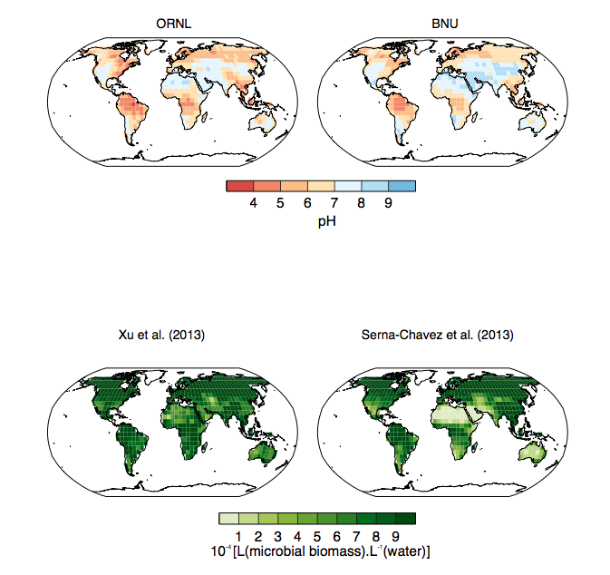


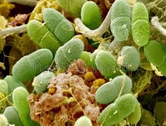
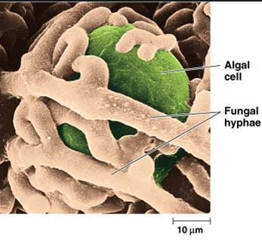


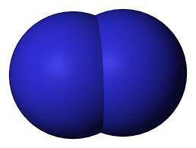
Atelier 3 : Plant-microbe-soil property interactions Q1 or 3?
COS sink
Scope for spatial
and temporal
modelling of
C and N cycling
O
C
S
Soil pH
Soil pH>6
+
+
Phototroph abundance increases with alkaline soil pH
N
+
+
Increase in fungal abundance
N
O
N2 sink
C
Soluble organic compounds
O
CO2 sink
Sauze et al., Soil, Biology & Biochemistry, 2017

Slide 7
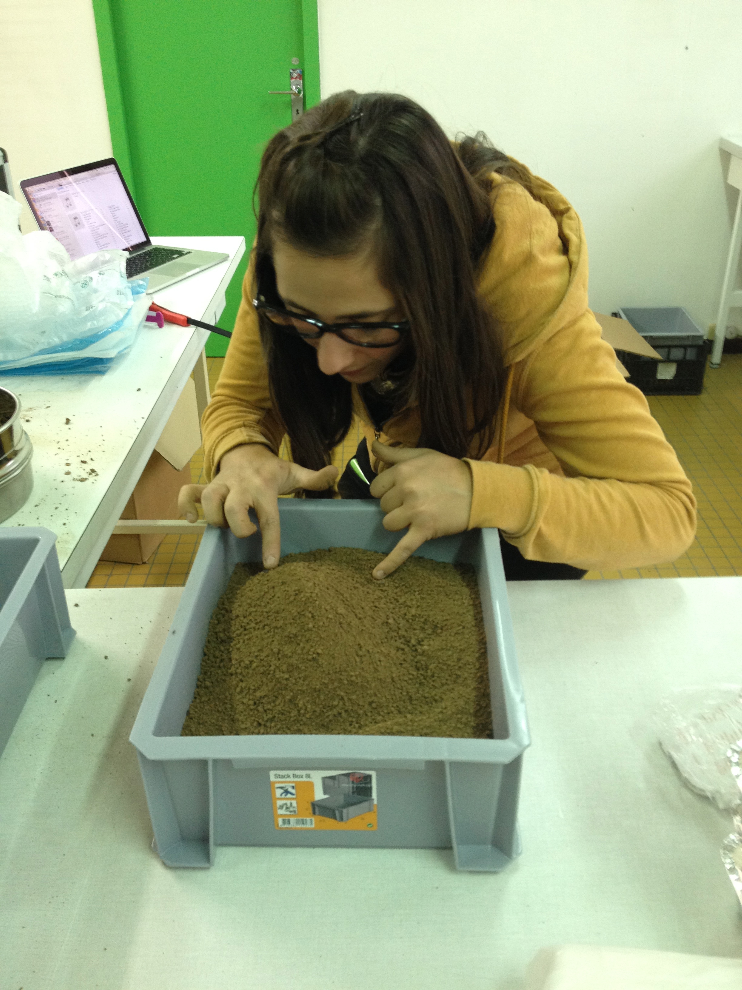
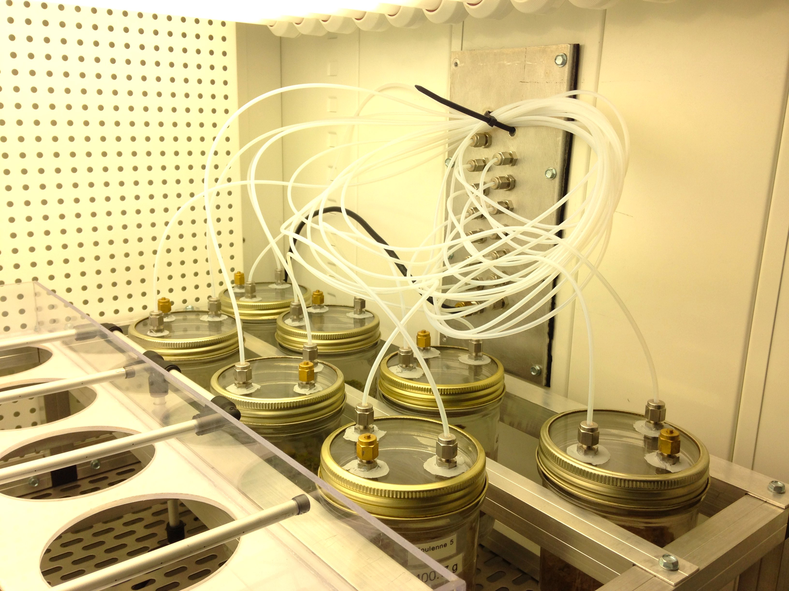
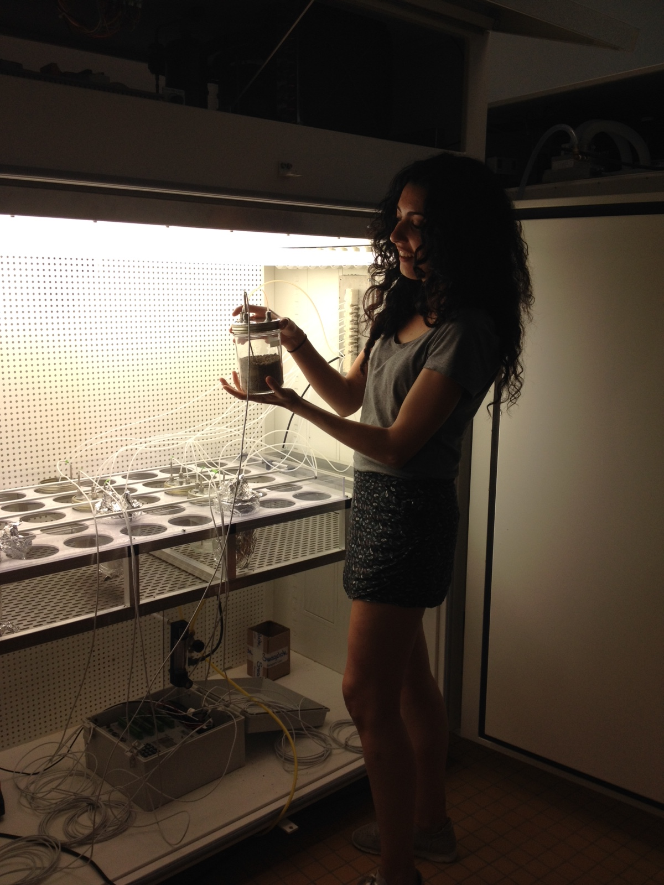
How are COS fluxes regulated by soil community?
Sauze et al., 2017

Slide 8
Influence of incubation on community structure
18S
16S
23S
Sauze et al., 2017

Slide 9
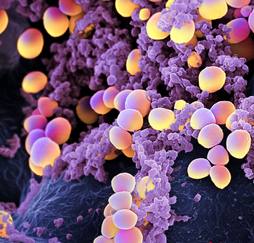
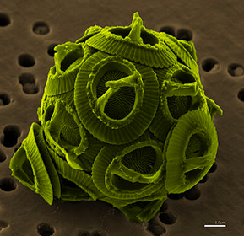
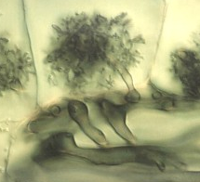
Influence of incubation on community structure
bacteria
bacterial (16S) abundance
[No. gene copies x 10⁸ g⁻¹ dry soil]
algae
algal (23S) abundance
[No. gene copies x 10⁸ g⁻¹ dry soil]
fungi
fungal (18S) abundance
[No. gene copies x 10⁸ g⁻¹ dry soil]
pH 4.5
pH 6.3
pH 7.0
pH 8.1
Sauze et al., 2017

Slide 10
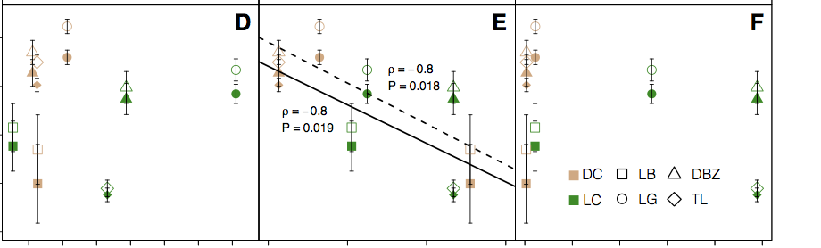
COS fluxes may be sensitive to fungal community size
bacteria
16S
fungi
18S
algae
23S
0
net
COS
flux
[pmol m⁻² s⁻¹]
-1
-2
-3
-4
800
1200
1600
10
15
20
25
200
600
1000
Number of gene copies (10⁷)
Sauze et al., 2017

Slide 11
0
net
COS
flux
[pmol m⁻² s⁻¹]
-1
-2
-3
-4
10
15
20
25
Number of fungal (18S)
gene copies
[10⁷]

Slide 12
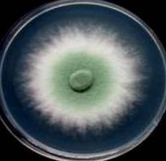
COS fluxes may be sensitive to fungal community size
30
pH=7
fungi
20
COS
hydrolysis
rate
[10³ s⁻¹]
pH=8
10
pH=4
pH=6
0
0.5
1.5
2.5
2.5
3.5
Number of fungal (18S) gene copies
[10⁸ g⁻¹ dry soil]
Sauze et al., Soil, Biology & Biochemistry, 2017

Slide 13
COS fluxes linked to fungal community composition?
0
net
COS
flux
[pmol m⁻² s⁻¹]
-1
-2
-3
-4
Larger fungal population
of COS consumers?
Number of fungal gene copies
Masaki et al., 2016; Sauze et al., 2017

Slide 14
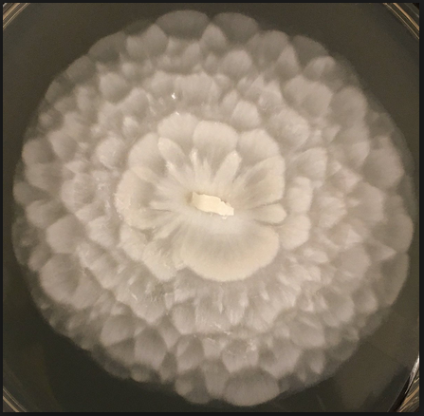
COS fluxes linked to fungal community composition?
Mucoromycotina ?
Smaller fungal population but
more COS emitters?
0
net
COS
flux
[pmol m⁻² s⁻¹]
-1
-2
-3
-4
Larger fungal population
of COS consumers?
Trichoderma ?
Number of fungal gene copies
Sauze et al., 2017

